Slide 1
Lecture-10
Speech Perception

Slide 2
Speech Perception
Understanding how we hear sounds and how we perceive speech → better design and implementation of robust and efficient systems for analyzing and representing speech
the better we understand signal processing in the human auditory system, the better we can (at least in theory) design practical speech processing systems like:
– speech coding
– speech recognition
Try to understand speech perception by looking at the physiological models of hearing

Slide 3
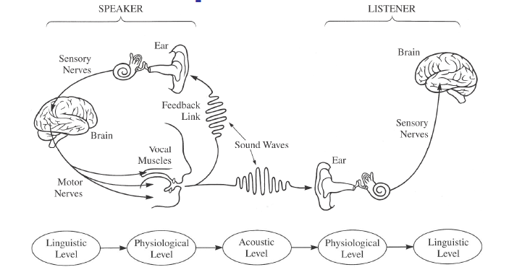
The Speech Chain
The Speech Chain comprises the processes of:
Speech production,
Auditory feedback to the speaker,
Speech transmission (through air or over an electronic
Communication system (to the listener), and
Speech perception and understanding by the listener.

Slide 4
The Speech Chain
The message to be conveyed by speech goes through five levels of representation between the speaker and the listener
the linguistic level (where the basic sounds of the communication are chosen to express some thought of idea)
the physiological level (where the vocal tract components produce the sounds associated with the linguistic units of the utterance)
the acoustic level (where sound is released from the lips and nostrils and transmitted to both the speaker (sound feedback) and to the listener
the physiological level (where the sound is analyzed by the ear and the auditory nerves), and finally
the linguistic level (where the speech is perceived as a sequence of linguistic units and understood in terms of the ideas being communicated)

Slide 5
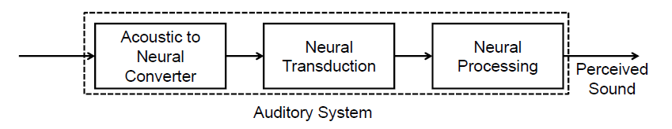
The Auditory System
The acoustic signal first converted to a neural representation by processing in the ear
The conversion takes place in stages at the outer, middle and inner ear
These processes can be measured and quantified
The neural transduction step takes place between the output of the inner ear and the neural pathways to the brain
Consists of a statistical process of nerve firings at the hair cells of the inner ear, which are transmitted along the auditory nerve to the brain
Much remains to be learned about this process
The nerve firing signals along the auditory nerve are processed by the brain to create the perceived sound corresponding to the spoken utterance
These processes not yet understood

Slide 6
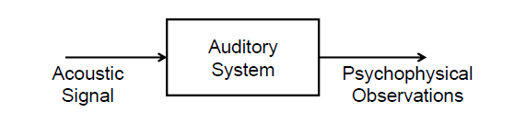
The Black Box Model of the Auditory System
Researchers have resorted to a “black box” behavioral model of hearing and perception
Model assumes that an acoustic signal enters the auditory system causing behavior that we record as psychophysical observations
Psychophysical methods and sound perception experiments determine how the brain processes signals with different loudness levels, different spectral characteristics, and different temporal properties
Characteristics of the physical sound are varied in a systematic manner and the psychophysical observations of the human listener are recorded and correlated with the physical attributes of the incoming sound
Then determine how various attributes of sound (or speech) are processed by the auditory system

Slide 7
Why Do We Have Two Ears
Sound localization – spatially locate sound sources in 3-dimensional sound fields
Sound cancellation – focus attention on a ‘selected’ sound source in an array of sound sources – ‘cocktail party effect’
Effect of listening over headphones => localize sounds inside the head (rather than spatially outside the head)

Slide 8
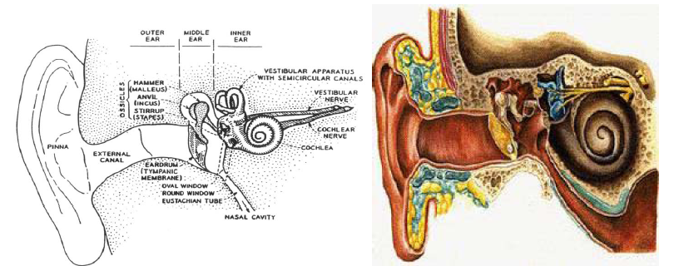
The Human Ear
Outer ear: pinna and external canal
Middle ear: tympanic membrane or eardrum
Inner ear: cochlea, neural connections

Slide 9
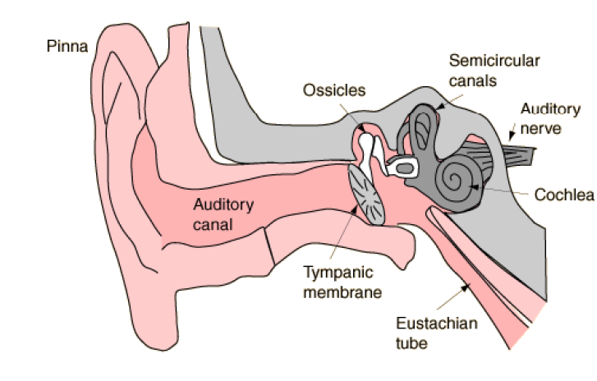
Ear and Hearing

Slide 10
Human Ear
Outer ear: funnels sound into ear canal
Middle ear: sound impinges on tympanic membrane; this causes motion
Middle ear is a mechanical transducer, consisting of the hammer, anvil and stirrup; it converts acoustical sound wave to mechanical vibrations along the inner ear
Inner ear: the cochlea is a fluid-filled chamber partitioned by the basilar membrane
The auditory nerve is connected to the basilar membrane via inner hair cells
Mechanical vibrations at the entrance to the cochlea create standing waves (of fluid inside the cochlea) causing basilar membrane to vibrate at frequencies commensurate with the input acoustic wave frequencies (formants) and at a place along the basilar membrane that is associated with these frequencies

Slide 11
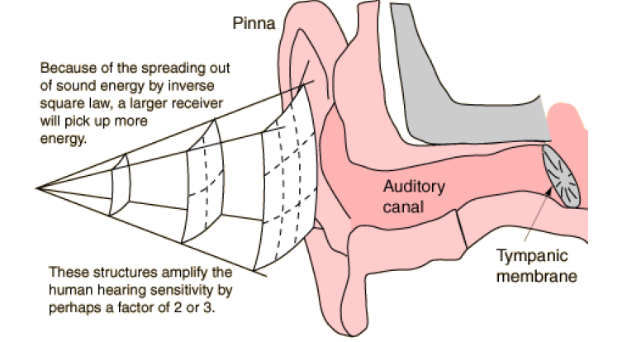
The Outer Ear

Slide 12
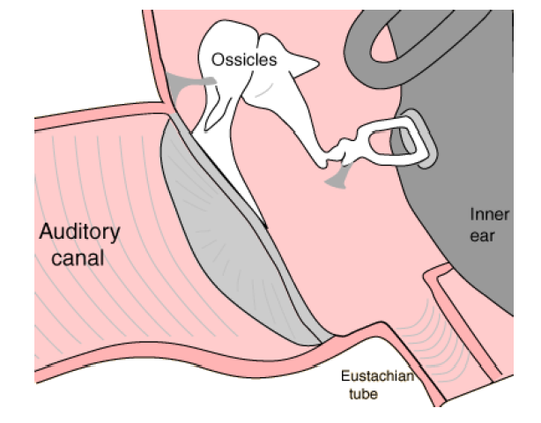
The Outer Ear

Slide 13
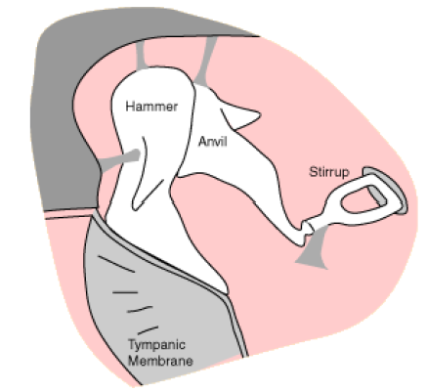
The Middle Ear
The Hammer (Malleus), Anvil (Incus) and Stirrup (Stapes) are the three tiniest bones in the body. Together they form the coupling between the vibration of the eardrum and the forces exerted on the oval window of the inner ear.
These bones can be thought of as a compound lever which achieves a multiplication of force—by a factor of about three under optimum conditions. (They also protect the ear against loud sounds by attenuating the sound.)

Slide 14
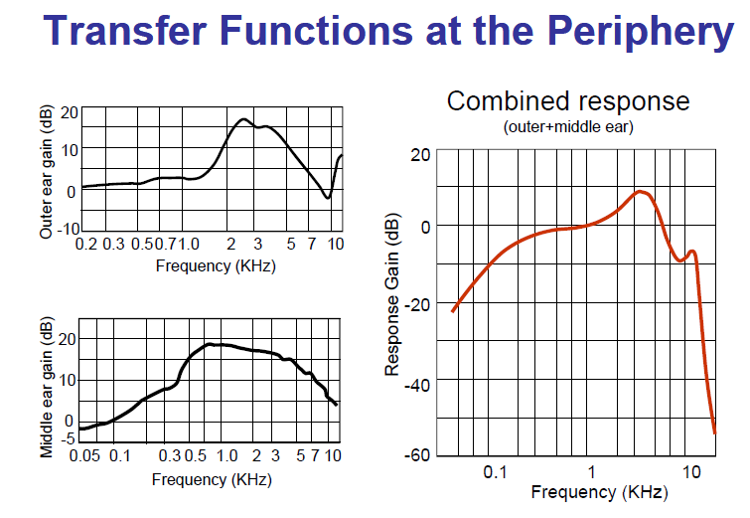

Slide 15
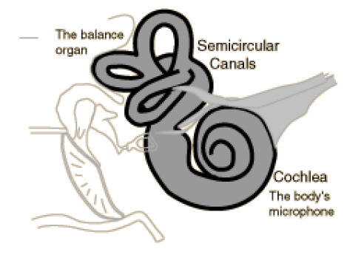
The Inner Ear
The inner ear can be thought of as two organs, namely the semicircular canals which serve as the body’s balance organ and the cochlea which serves as the body’s microphone, converting sound pressure signals from the outer ear into electrical impulses which are passed on to the brain via the auditory nerve.

Slide 16
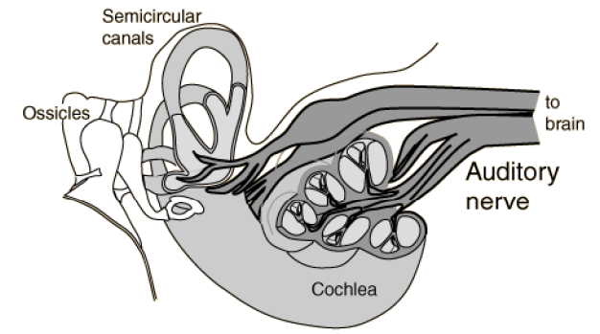
The Auditory Nerve
Taking electrical impulses from the cochlea and the semicircular canals, the auditory nerve makes connections with both auditory areas of the brain.

Slide 17
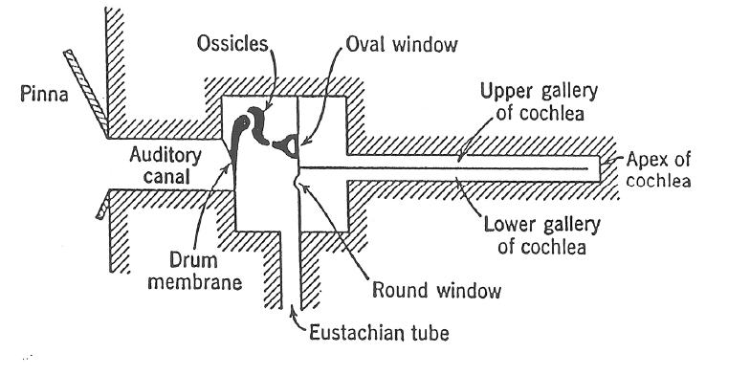
Schematic Representation of the Ear

Slide 18
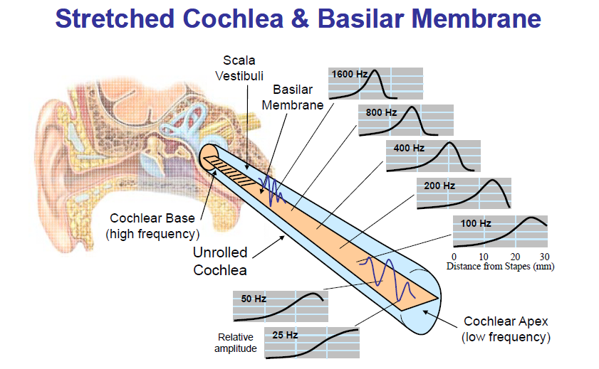

Slide 19
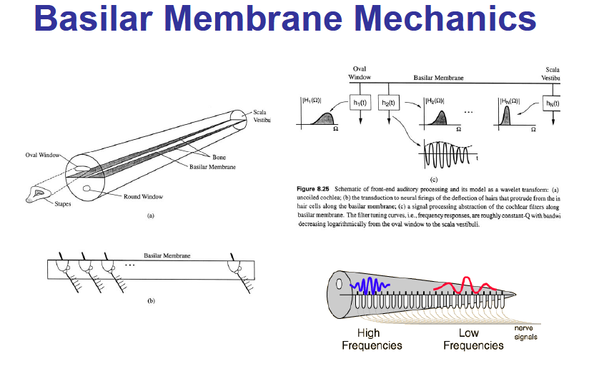

Slide 20
Basilar Membrane Mechanics
Characterized by a set of frequency responses at different points along the membrane
Mechanical realization of a bank of filters
Filters are roughly constant Q (center frequency/bandwidth) with logarithmically decreasing bandwidth
Distributed along the Basilar Membrane is a set of sensors called Inner Hair Cells (IHC) which act as mechanical motion-to-neural activity converters
Mechanical motion along the BM is sensed by local IHC causing firing activity at nerve fibers that innervate bottom of each IHC
Each IHC connected to about 10 nerve fibers, each of different diameter => thin fibers fire at high motion levels, thick fibers fire at lower motion levels
30,000 nerve fibers link IHC to auditory nerve
Electrical pulses run along auditory nerve, ultimately reach higher levels of auditory processing in brain, perceived as sound

Slide 21
Basilar Membrane Motion
The ear is excited by the input acoustic wave which has the spectral properties of the speech being produced
Different regions of the BM respond maximally to different input frequencies => frequency tuning occurs along BM
The BM acts like a bank of non-uniform cochlear filters
Roughly logarithmic increase in BW of filters (<800 Hz has equal BW) => constant Q filters with BW decreasing as we move away from cochlear opening
Peak frequency at which maximum response occurs along the BM is called the characteristic frequency

Slide 22
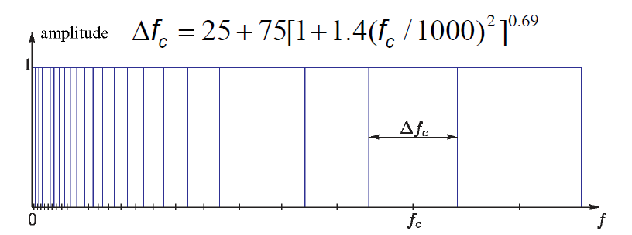
Critical Bands
Real BM filters overlap significantly

Slide 23
The Perception of Sound
Key questions about sound perception:
--what is the `resolving power’ of the hearing mechanism
– how good an estimate of the fundamental frequency of a sound do we need so that the perception mechanism basically `can’t tell the difference’
– how good an estimate of the resonances or formants (both center frequency and bandwidth) of a sound do we need so that when we synthesize the sound, the listener can’t tell the difference
– how good an estimate of the intensity of a sound do we need so that when we synthesize it, the level appears to be correct

Slide 24
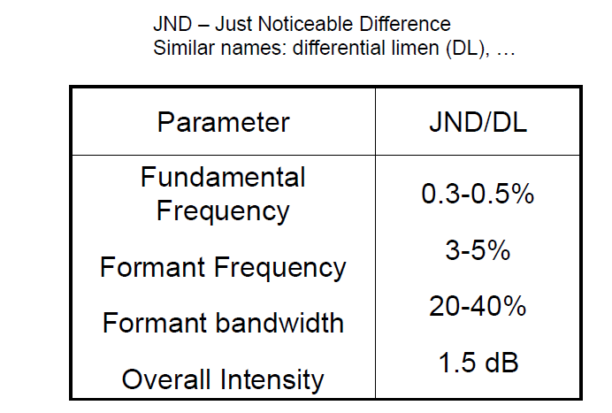
Parameter Discrimination

Slide 25
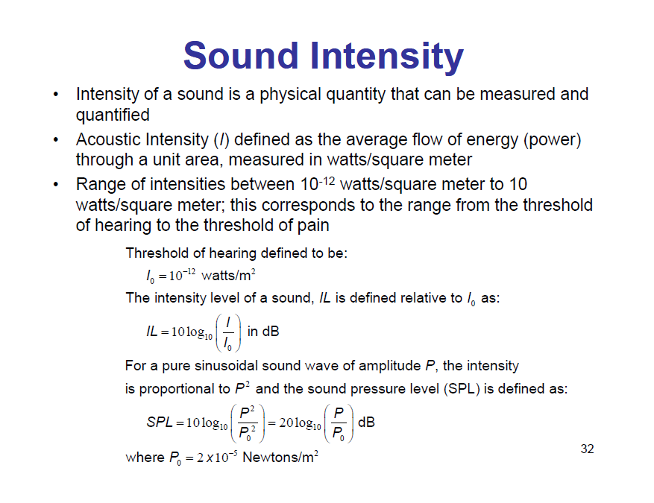

Slide 26
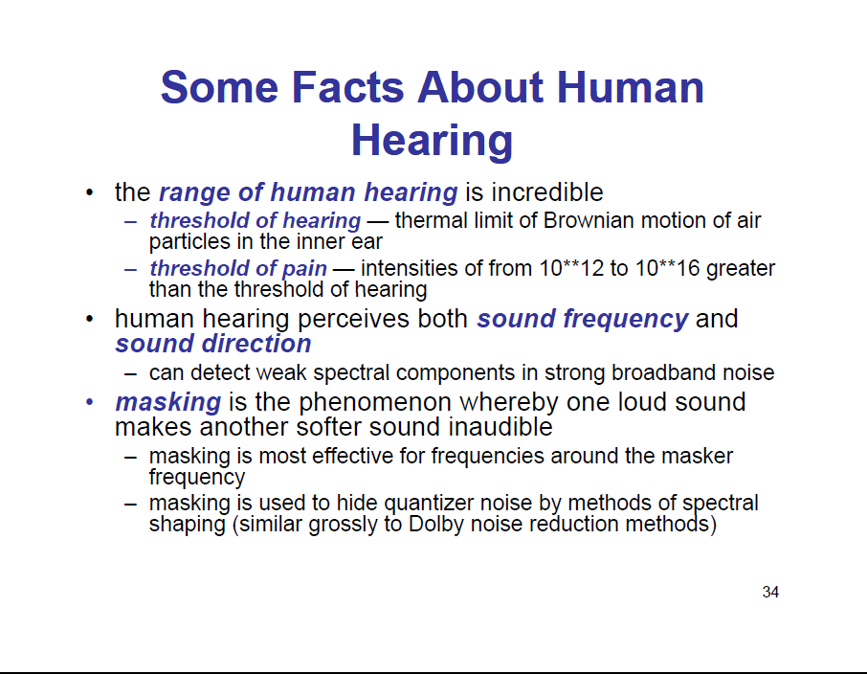

Slide 27
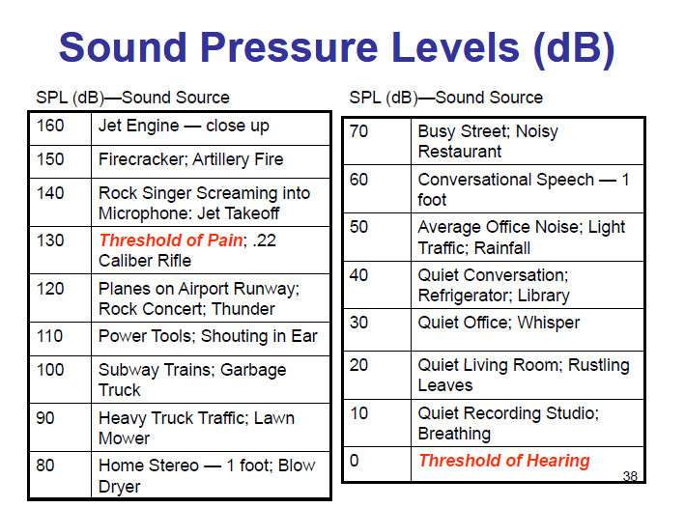

Slide 28
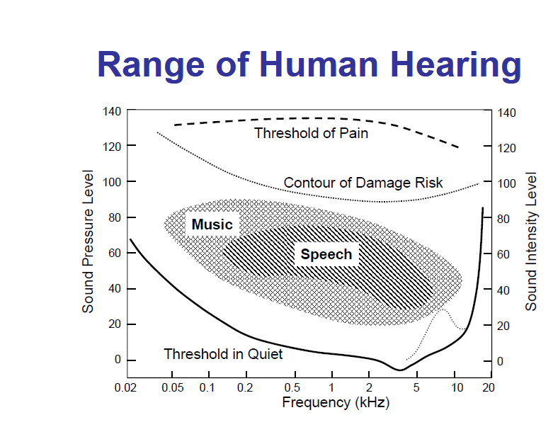

Slide 29
Hearing Thresholds
Threshold of Audibility is the acoustic intensity
level of a pure tone that can barely be heard at a particular frequency
– threshold of audibility ≈ 0 dB at 1000 Hz
– threshold of feeling ≈ 120 dB
– threshold of pain ≈ 140 dB
– immediate damage ≈ 160 dB
• Thresholds vary with frequency and from person-to-person
• Maximum sensitivity is at about 3000 Hz

Slide 30
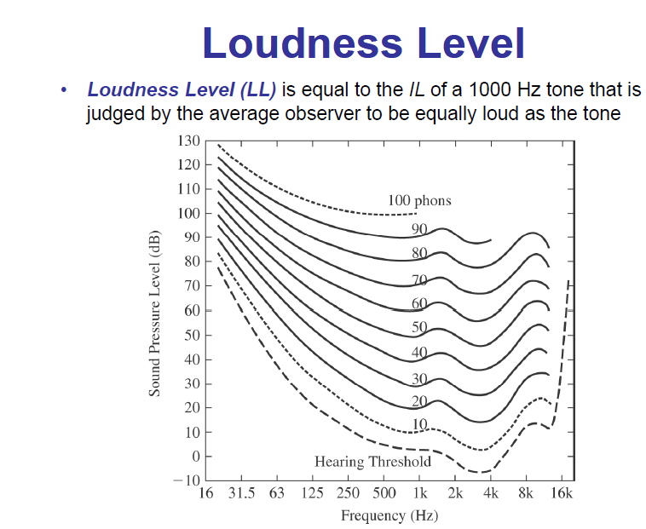

Slide 31
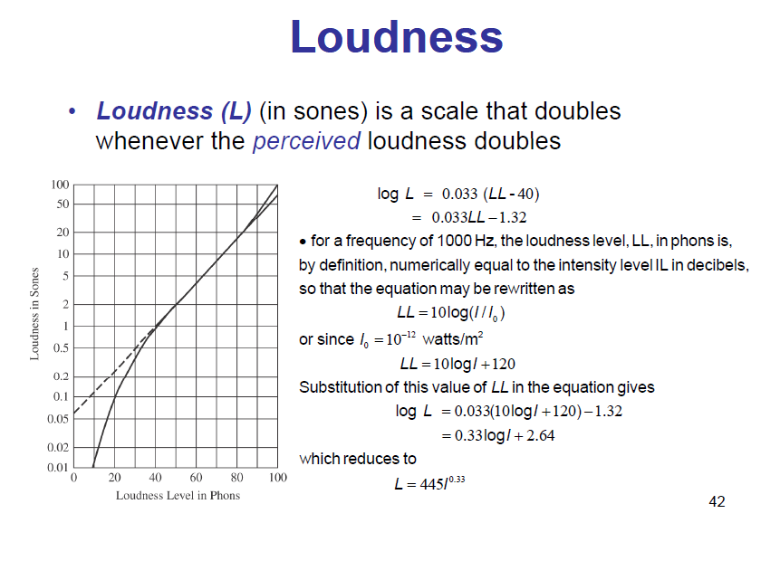

Slide 32
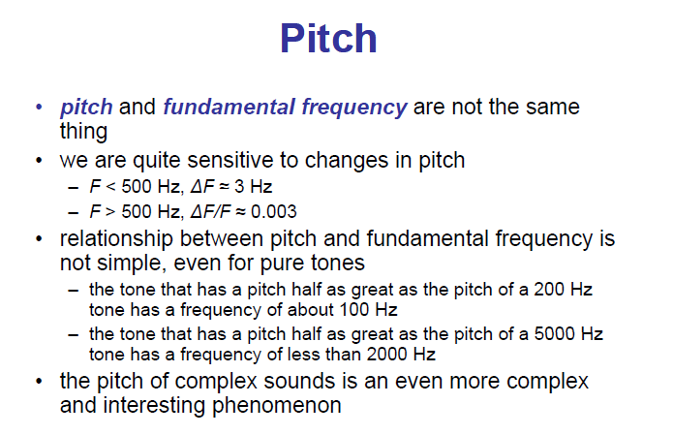

Slide 33
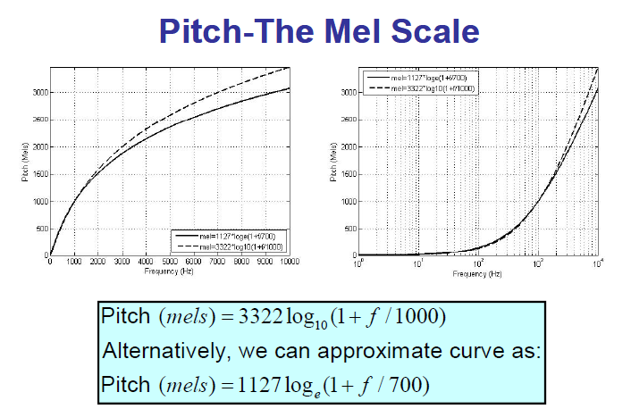

Slide 34
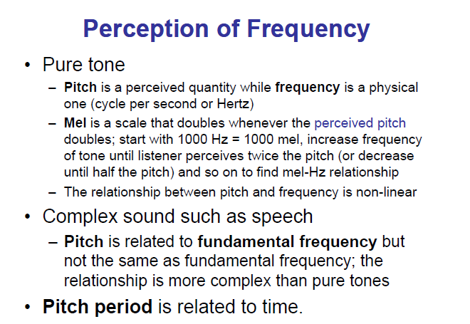

Slide 35
END

Slide 36
Masking as defined by the American Standards Association (ASA) is the amount (or the process) by which the threshold of audibility for one sound is raised by the presence of another (masking) sound (B.C.J. Moore 1982, p. 74)

Slide 37
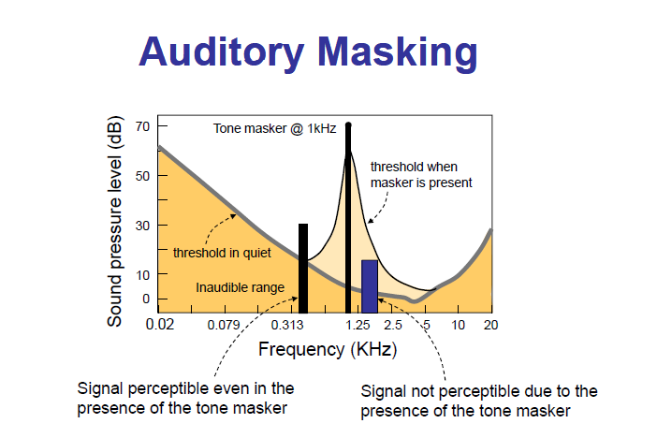

Slide 38
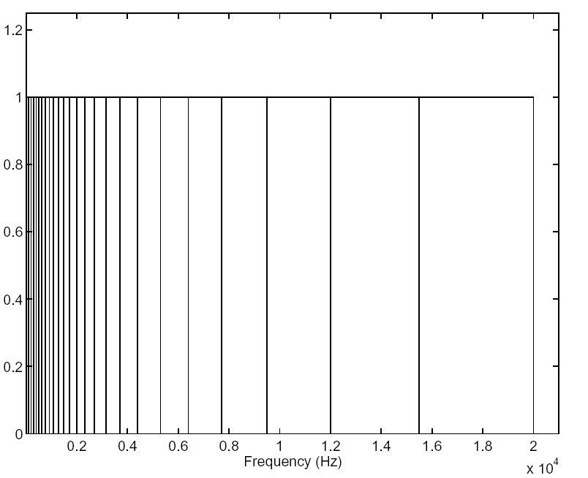
About 75% of the critical bands are below 5 kHz
The hearing system receives more information from these low frequencies.
Approximately, the critical bandwidth is 100 Hz up to 500 Hz
Above 500 Hz, the critical bandwidth is approximately 20% of the center frequency .
Nonuniform AUDITORY FILTERBANK
A critical band is the bandwidth around a center frequency beyond which subjective responses of the hearing system abruptly change
The hearing system contains a bank of overlapping band pass linear filters.
Therefore, the peripheral section of the hearing system can be modeled as a non uniform filter bank consisting of band pass filter with bandwidths equal to critical bandwidths.

Slide 39

Critical Bands
The ear cannot distinguish sounds within the same band that occur simultaneously.
Each band is called a critical band
The auditory system can be roughly modeled as a filterbank, consisting of 25 overlapping bandpass filters, from 0 to 20 KHz
The bandwidth of each critical band is about 100 Hz for signals below 500 Hz, and increases non-linearly after 500 Hz up to 5000 Hz
1 bark = width of 1 critical band

Slide 40
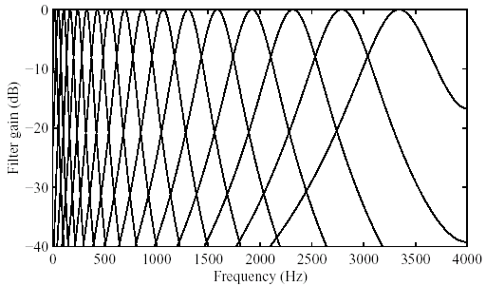
Critical Bands
Critical bands: The widths of the masking bands for different masking tones are different, increasing with the frequency of the masking tone.

Slide 41

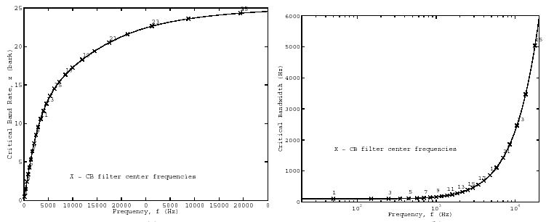
Although the function BWc is continuous, it is useful when building practical systems to treat the ear as a discrete set of bandpass filters that conforms to Eq.

Slide 42
Cochlea-Overlapping Bandpass Filter
A frequency-to-place transformation takes place in the cochlea (inner ear), along the basilar membrane.
Distinct regions in the cochlea, each with a set of neural receptors, are “tuned” to different frequency bands.
In fact, the cochlea can be viewed as a bank of highly overlapping band-pass filters.
The magnitude responses are asymmetric and non-linear (level-dependent).
Moreover, the cochlear filter pass-bands are of non-uniform bandwidth, and the bandwidths increase with increasing frequency.
The “critical bandwidth” is a function of frequency that quantifies the cochlear filter pass-bands.

Slide 43

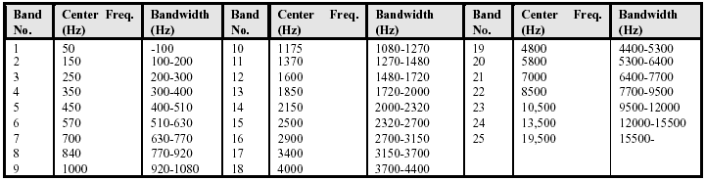
Cochlea-Overlapping Bandpass Filter
A distance of 1 critical band is commonly referred to as “one bark” in the literature.

Slide 44
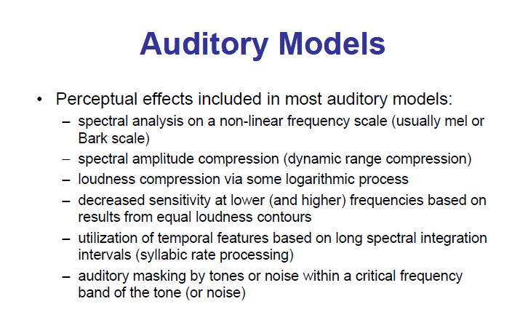

Slide 45
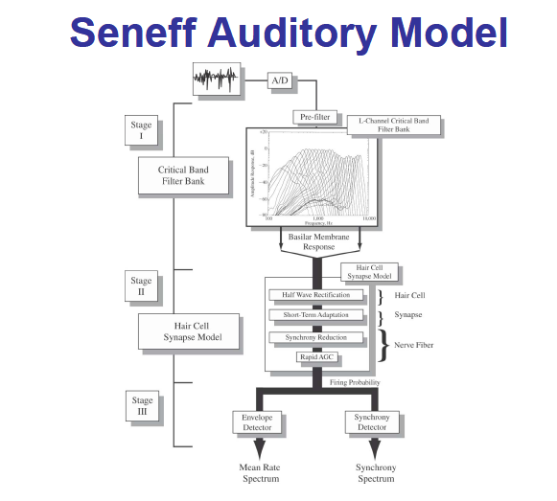

Slide 46
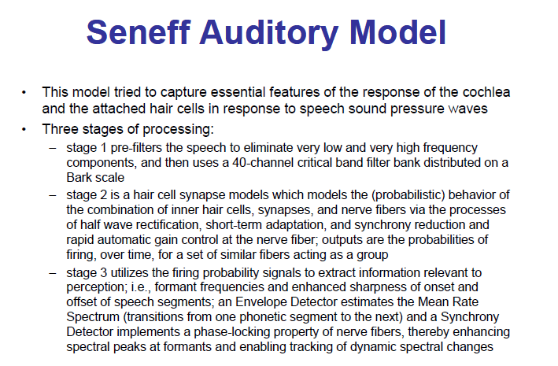

Slide 47
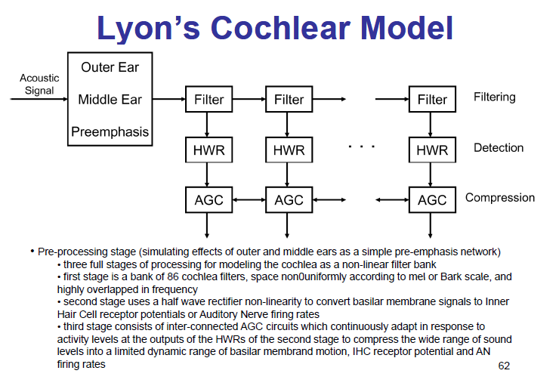

Slide 48
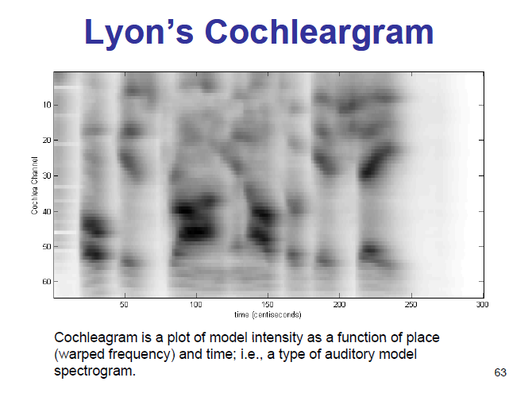

Slide 49
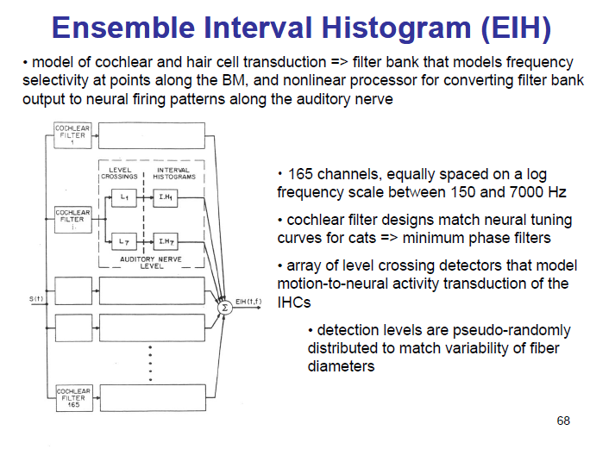

Slide 50
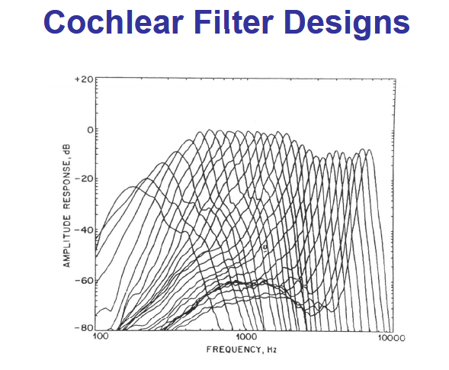

Slide 51
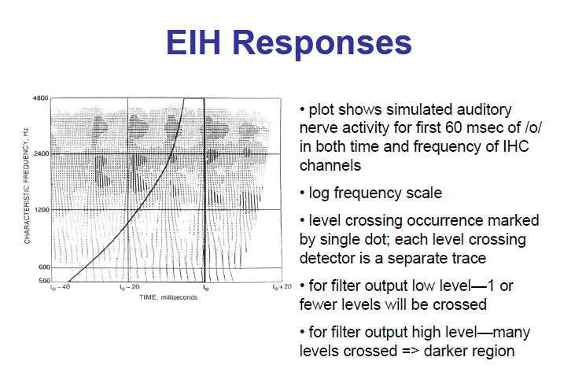

Slide 52
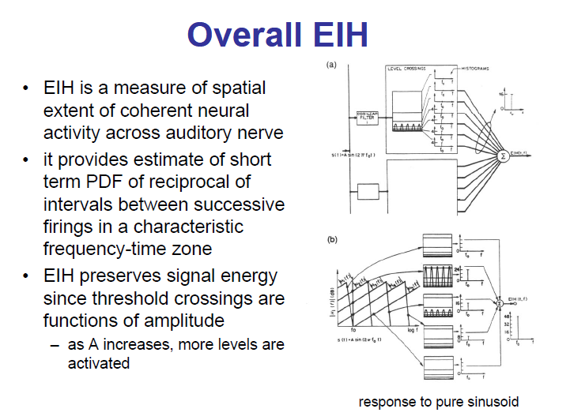

Slide 53
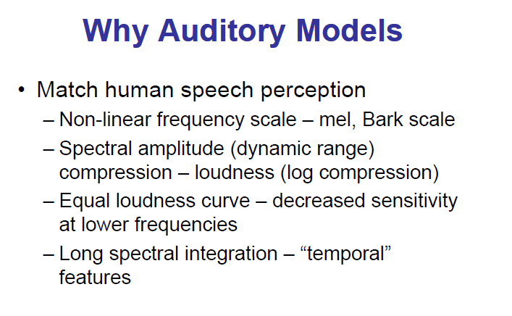

Slide 54
